Slide 1
Challenge Problem 6: Image Labeling on Flickr
Tom Dietterich, Oregon State
Roddy Collins, Kitware
Chad Scherrer, Galois

Slide 2
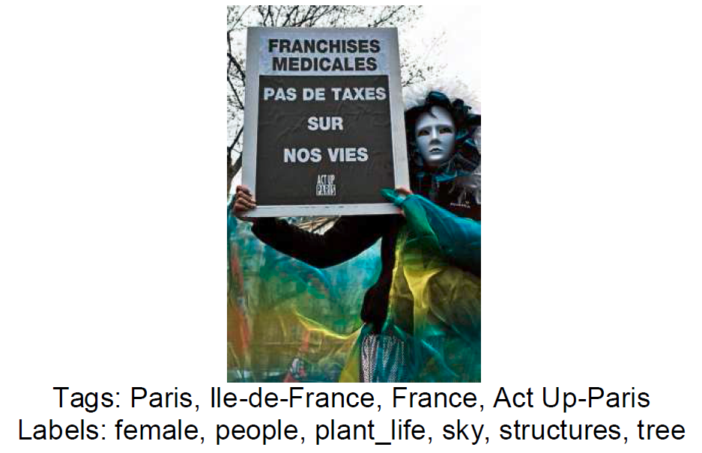
Introduction to Flickr
User A uploads an image to Flickr
User A provides a title for the image
User A (or other users) can add free-form text tags to the image
User A can define an Album and include the image in the album
Other users can create one or more Galleries and include the image in it
Our data set will also include labels assigned to each image. These are drawn from a fixed set of labels.
Goal: Predict the labels

Slide 3
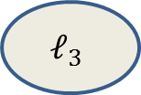


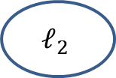


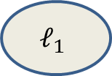







Graphical Model View
$$ℓ_{1}$$
$$ℓ_{2}$$
$$ℓ_{3}$$
$$ℓ_{4}$$
Labels
$$I_{1}$$
$$I_{2}$$
$$I_{3}$$
$$I_{4}$$
Images
$$M_{1}$$
$$M_{2}$$
$$M_{3}$$
$$M_{4}$$
Meta Data
Title
User Tags
Groupings
(Albums, Galleries)
$$G_{1}$$
$$G_{4}$$

Slide 4
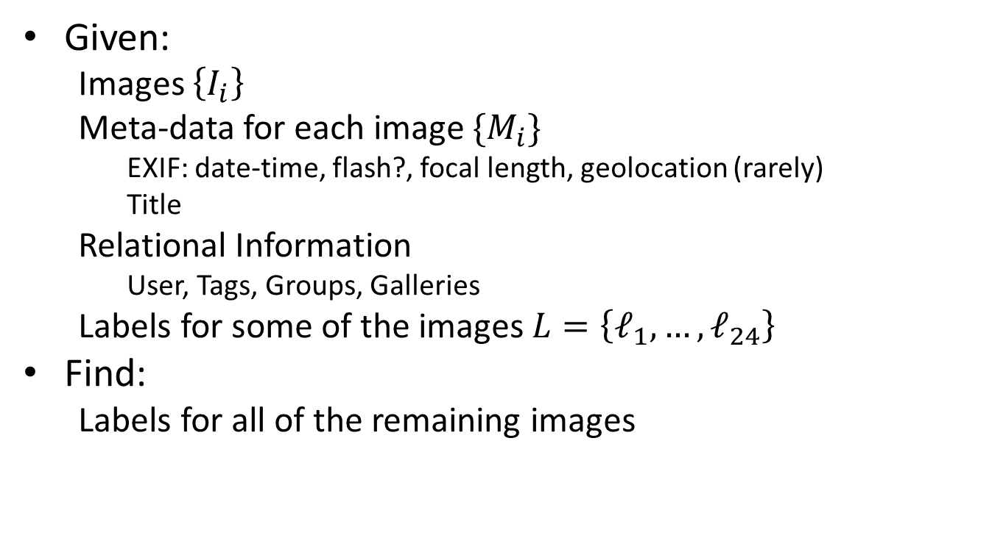
Formal Statement
Given:
Images $\left\{I_{i}\right\}$
Meta-data for each image ${\{M}_{i}\}$
EXIF: date-time, flash?, focal length, geolocation (rarely)
Title
Relational Information
User, Tags, Groups, Galleries
Labels for some of the images $L=\left\{ℓ_{1},…,ℓ_{24}\right\}$
Find:
Labels for all of the remaining images

Slide 5

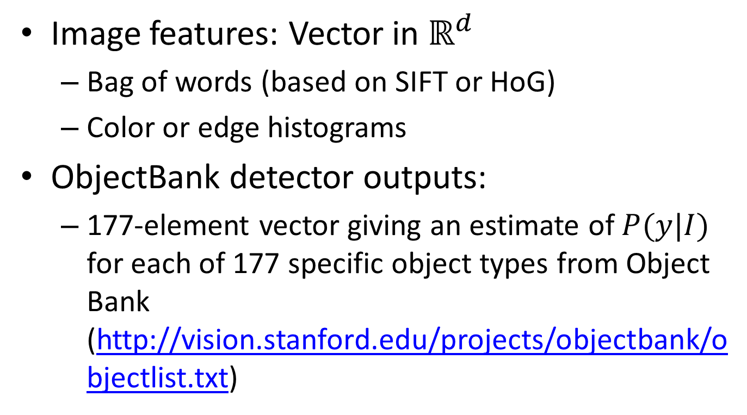
Image Encoding ($x$)
Image features: Vector in $ℝ^{d}$
Bag of words (based on SIFT or HoG)
Color or edge histograms
ObjectBank detector outputs:
177-element vector giving an estimate of $P(y|I)$ for each of 177 specific object types from Object Bank (http://vision.stanford.edu/projects/objectbank/objectlist.txt)

Slide 6
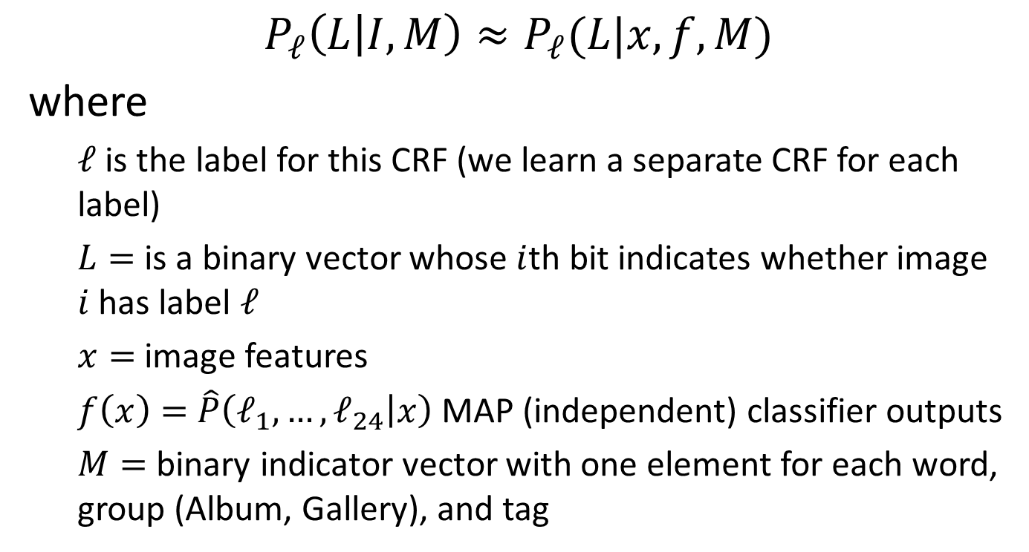
Probabilistic Model: Conditional Random Field
$$P_{ℓ}\left(L | I,M\right)≈P_{ℓ}(L|x,f,M)$$
where
$ℓ$ is the label for this CRF (we learn a separate CRF for each label)
$L=$ is a binary vector whose $i$th bit indicates whether image $i$ has label $ℓ$
$x=$ image features
$f\left(x\right)=$ $\hat{P}\left(ℓ_{1},…,ℓ_{24} | x\right)$ MAP (independent) classifier outputs
$M=$ binary indicator vector with one element for each word, group (Album, Gallery), and tag

Slide 7
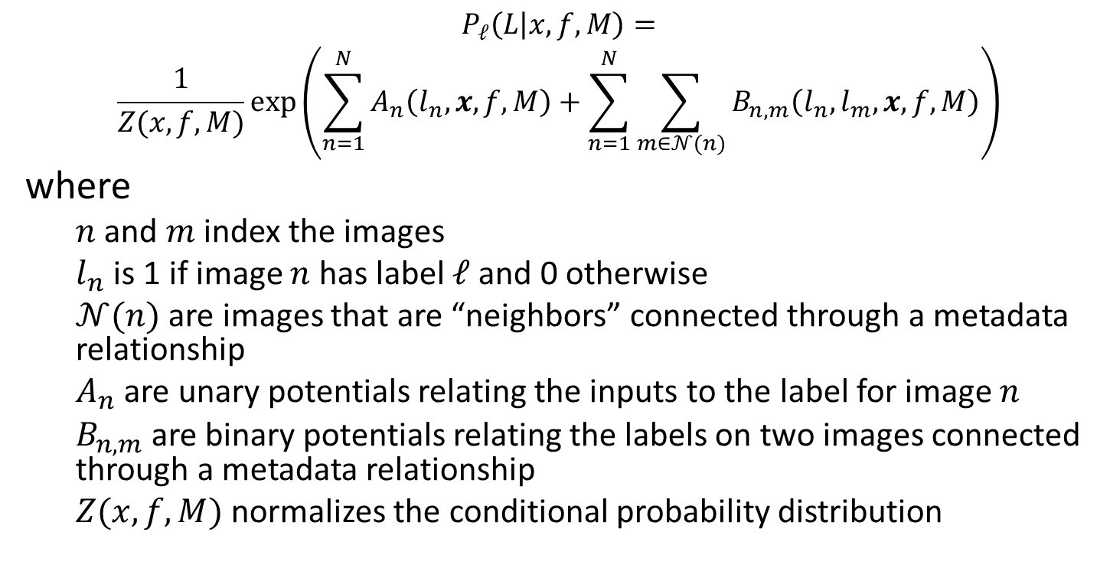
Per-Label CRF
$$P_{ℓ}\left(L | x,f,M\right)=$$
$$\frac{1}{Z(x,f,M)}\exp\left(\sum_{n=1}^{N}{A_{n}\left(l_{n},x,f,M\right)}+\sum_{n=1}^{N}{\sum_{m∈𝒩(n)}{B_{n,m}\left(l_{n},l_{m},x,f,M\right)}}\right)$$
where
$n$ and $m$ index the images
$l_{n}$ is 1 if image $n$ has label $ℓ$ and 0 otherwise
$𝒩(n)$ are images that are “neighbors” connected through a metadata relationship
$A_{n}$ are unary potentials relating the inputs to the label for image $n$
$B_{n,m}$are binary potentials relating the labels on two images connected through a metadata relationship
$Z(x,f,M)$ normalizes the conditional probability distribution

Slide 8
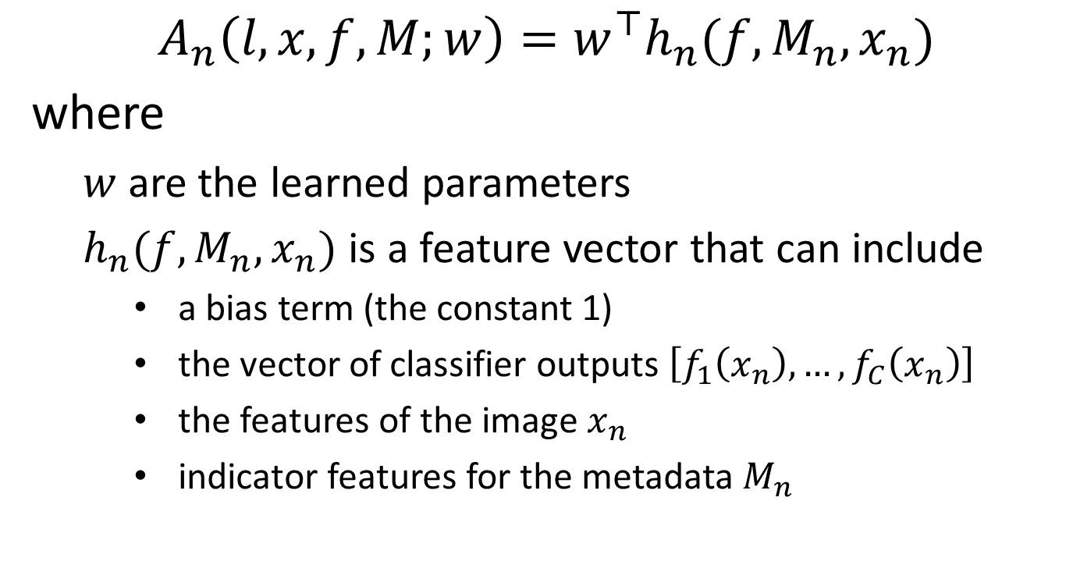

Parameterized $A_{n}$ and $B_{n,m}$
$$A_{n}\left(l,x,f,M;w\right)=w^{⊤}h_{n}(f,M_{n},x_{n})$$
where
$w$ are the learned parameters
$h_{n}(f,M_{n},x_{n})$ is a feature vector that can include
a bias term (the constant 1)
the vector of classifier outputs $\left[f_{1}\left(x_{n}\right),…,f_{C}\left(x_{n}\right)\right]$
the features of the image $x_{n}$
indicator features for the metadata $M_{n}$

Slide 9
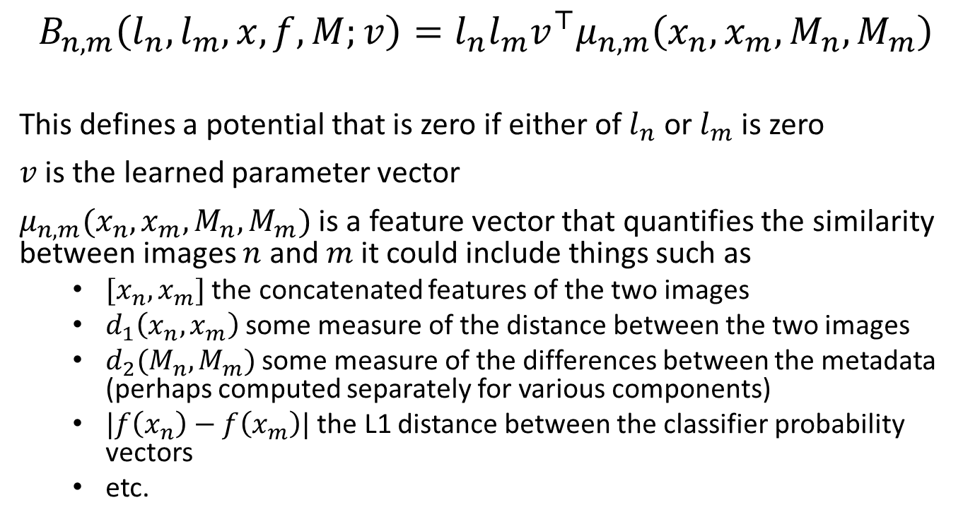

Parameterizing $B_{n,m}$
$$B_{n,m}\left(l_{n},l_{m},x,f,M;v\right)=l_{n}l_{m}v^{⊤}μ_{n,m}\left(x_{n},x_{m},M_{n},M_{m}\right)$$
This defines a potential that is zero if either of $l_{n}$ or $l_{m}$ is zero
$v$ is the learned parameter vector
$μ_{n,m}(x_{n},x_{m},M_{n},M_{m})$ is a feature vector that quantifies the similarity between images $n$ and $m$ it could include things such as
$[x_{n},x_{m}]$ the concatenated features of the two images
$d_{1}\left(x_{n},x_{m}\right)$ some measure of the distance between the two images
$d_{2}(M_{n},M_{m})$ some measure of the differences between the metadata (perhaps computed separately for various components)
$|f\left(x_{n}\right)−f\left(x_{m}\right)|$ the L1 distance between the classifier probability vectors
etc.

Slide 10
Model Fitting
Penalized MLE
equivalent to MAP with zero-mean Gaussian prior on all parameters
Penalized maximum margin
non-probabilistic baseline

Slide 11
Data: Subsets of MIRFLICKR
MIRFLIKR (Huiskes & Lew, 2008): 25,000 images
Subset of 14,600 images selected by McAuley et al., 2012.
CP6 will use a subset of 12,889 images (due to licensing and logistical issues)

Slide 12
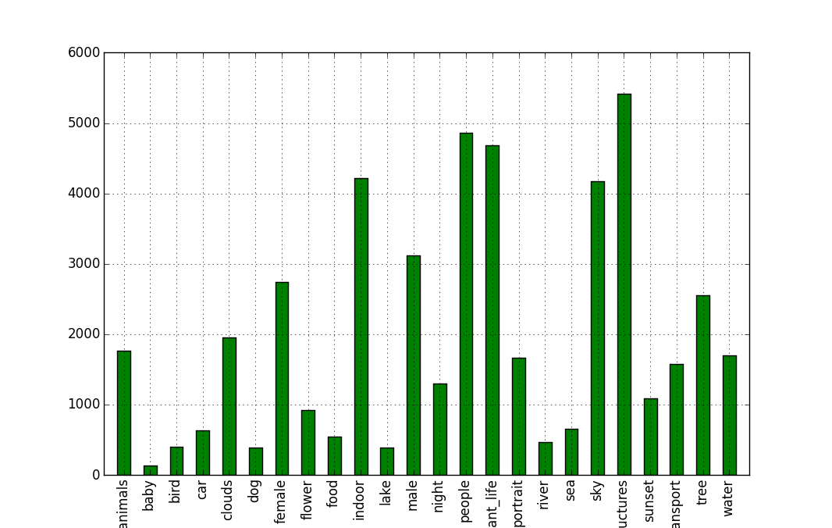
Label Distribution

Slide 13
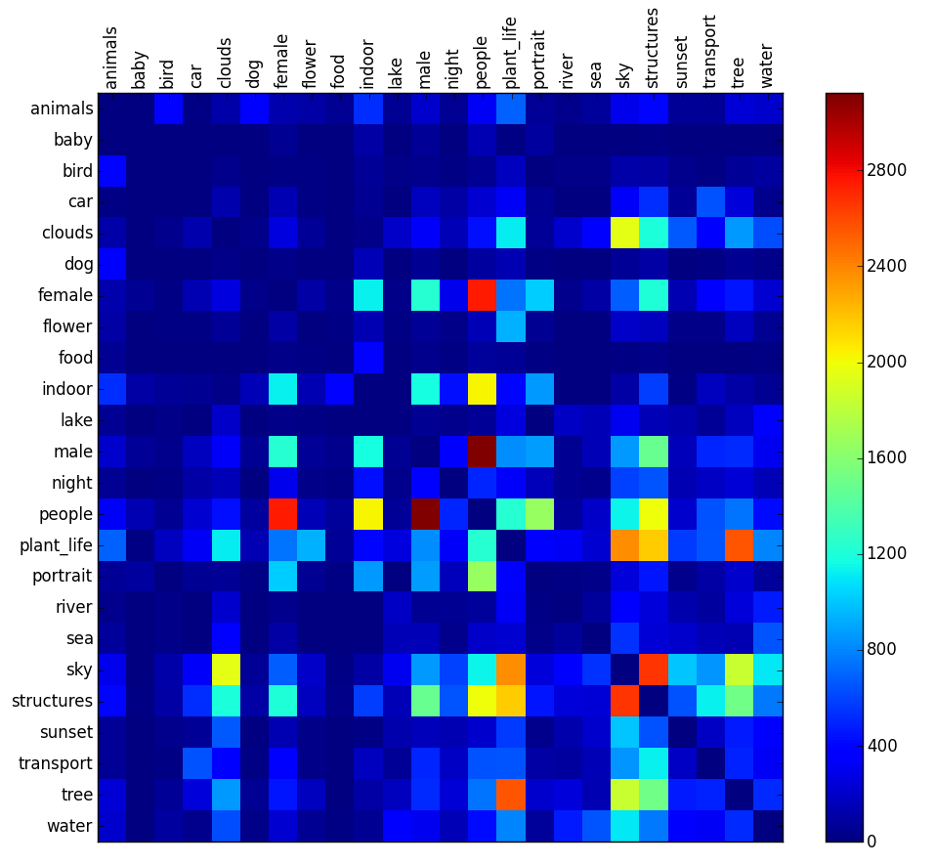
Label Co-occurrence Matrix

Slide 14
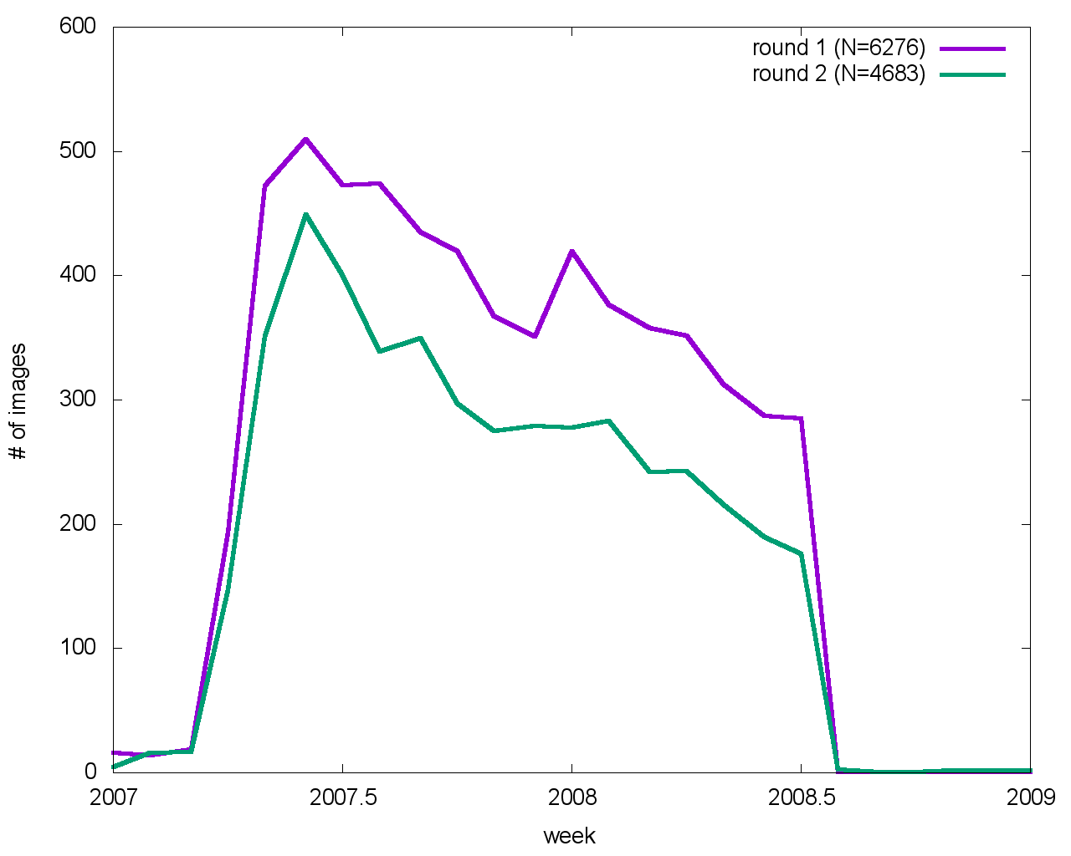
Train/Test Split
Train/test split based on image date (Dec 2007)
Images without date information will be used in training
Data sets
Phase 1 (July 2015 →January 2016)
images without the “structures” tag (most common): 7269 images
Phase 2 (January 2016 →July 2016)
all images

Slide 15
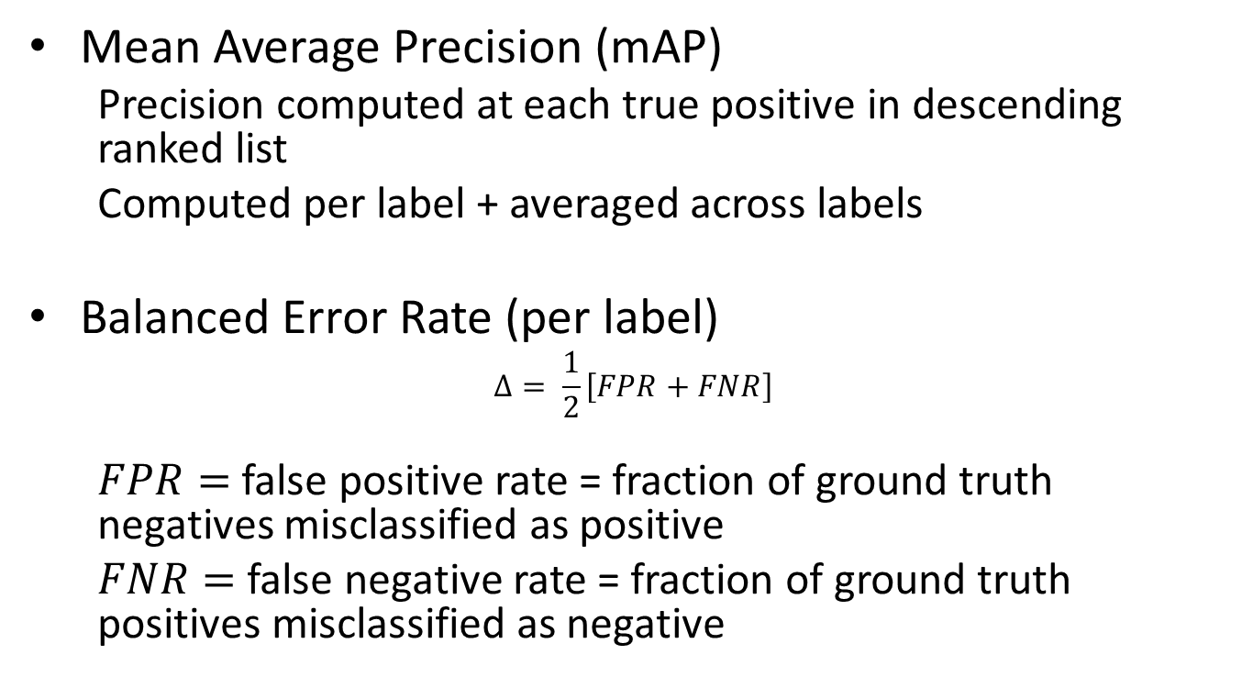
Metrics
Mean Average Precision (mAP)
Precision computed at each true positive in descending ranked list
Computed per label + averaged across labels
Balanced Error Rate (per label)
$$Δ= \frac{1}{2}\left[FPR+FNR\right]$$
$FPR=$ false positive rate = fraction of ground truth negatives misclassified as positive
$FNR=$ false negative rate = fraction of ground truth positives misclassified as negative

Slide 16
Metrics (2)
Program size (lines of code after excluding comments and white space)
Computational cost: execution time and peak memory
Qualitative: Modularity of solution (e.g., ease of changing features in the potential functions)

Slide 17
Challenge Problem Dimensions
Domain Class
Data Structure
Model Structure
Query Structure
DoD-related
Platforms
ISR
C3
Intelligence Analysis
Types:
Continuous
Discrete
Hybrid
Directed?:
Directed
Undirected
Query Type:
MAP
Marginal MAP
Expectation
Posterior Distribution
Posterior Summary
Anomalies
Structure:
Vector
Relational
Sequence
Parametric?:
Parametric
Nonparametric
Industry
Platforms
C3
# of Objects or Entities:
Fixed
Variable
Query Timing:
One shot
Amortized
Tracking
Content:
Signals
Counts
Tracklets
Text
Images
3D MRI images
Aircraft tracks
Medicine and Science
Bird migration
Brain segmentation
Operational Tempo:
Fast
Slow
Latent Variables?:
Observed
Latent
Stationarity:
Stationary
Change points
Both

Slide 18
CP#6 Next Evaluation Period
Timeline
October 15-30: Beta Period
45 Days before PI meeting: Final Deadline for CP5 and CP6 solutions
January ??: PI Meeting (co-located but not conflicting with POPL)

Slide 19
CP#6 Materials Available Now
http://ppaml.galois.com/wiki/wiki/CP6ImageLabeling
http://ppaml.kitware.com/midas/
Email address for questions, issues, etc.:
ppaml-support@community.galois.com

Slide 20
Future Challenge Problems
TA1/DARPA are discussing possible changes in future Challenge Problems
One idea is to tackle one or more “Grand Challenge” problems where probabilistic programming has high potential to advance the state of the art
Each TA2-4 team is encouraged to send a representative to the Micro Breakout on this topic

